Slide 1
Derivatives
Options on Bonds and Interest Rates
Professor André Farber
Solvay Business School
Université Libre de Bruxelles

Slide 2
Caps
Floors
Swaption
Options on IR futures
Options on Government bond futures

Slide 3
Introduction
A difficult but important topic:
Black-Scholes collapses:
  1. Volatility of underlying asset constant
  2. Interest rate constant
For bonds:
  1. Volatility decreases with time
  2. Uncertainty due to changes in interest rates
  3. Source of uncertainty: term structure of interest rates
3 approaches:
1. Stick of Black-Scholes
2. Model term structure : interest rate models
3. Start from current term structure: arbitrage-free models
Notes:
We now address one of the most challenging questions: pricing options on fixed income securities. The practical importance of the matter is enormous. Interest rate risk is one of the main categories of risk. The bulk of the derivative activity is about interest rate risk. All financial institutions have options on interest rates in their books. Some are explicitly recognized as options. Many are imbedded in product bought or sold by a financial institution.
Why is it so difficult?
Think first about the evolution of a default-free bond over time. At maturity, the face value is known. It acts as a magnet for current prices: as the maturity date becomes closer, the market value of the bond is “pulled to par”. This has direct implications for the volatility. Remember duration. The longer the duration, the higher the percentage change in the bond price for a given change in the interest. For bonds, volatility is all but constant.
The value of bond vary with interest rate changes. But there is no such thing as “the” interest rates. As a matter of fact, there exist an infinite number of interest, one for each maturity. What makes the problem even more complicate is that these interest rates tend to move together to some extend.

Slide 4
Review: forward on zero-coupons
+M
Borrowing forward ↔ Selling forward a zero-coupon
Long FRA: [M (r-R) τ]/(1+rτ)
T
T*
0
τ
-M(1+Rτ)

Slide 5
Options on zero-coupons
Consider a 6-month call option on a 9-month zero-coupon with face value 100
Current spot price of zero-coupon = 95.60
Exercise price of call option = 98
Payoff at maturity: Max(0, S_{T} – 98)
The spot price of zero-coupon at the maturity of the option depend on the 3-month interest rate prevailing at that date.
S_{T} = 100 / (1 + r_{T} 0.25)
Exercise option if:
    S_{T} > 98
    r_{T} < 8.16%
Notes:
A call option on a zero-coupon a natural extension of a long forward contract on a zero-coupon. By setting the exercise price of the option, the interest rate earned from the option’s maturity until the maturity of the zero-coupon is fixed. In our example, buying the zero-coupon at 98.00 implies earning an interest rate (with simple compounding) of 8.16% for 3-month on the exercise price. This rate is the exercise rate of the option.
In a forward contract, this rate would be locked-in whatever the level of the 3-month interest rate at the maturity of the option. However, the profit from buying the zero-coupon at that price would be positive only if the 3-month interest prevailing on the market is below 8.16%.
Buying a call option gives the write not to buy the zero-coupon if the price is below the exercise price. This would be the case if the 3-month interest rate of greater than the fixed rate implicit in the striking price.

Slide 6
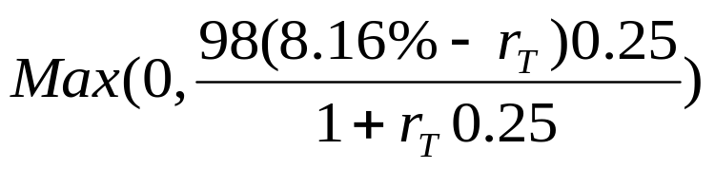
Payoff of a call option on a zero-coupon
The exercise rate of the call option is R = 8.16%
With a little bit of algebra, the payoff of the option can be written as:
Interpretation: the payoff of an interest rate put option
The owner of an IR put option:
    Receives the difference (if positive) between a fixed rate and a variable rate
    Calculated on a notional amount
    For an fixed length of time
    At the beginning of the IR period
Notes:
The payoff of the option is:
Max(0, S_{T} – 98.00) = Max[0, 98.00*(S_{T}/98.00 – 1)]
The exercise rate of the option is defined as the solution of:
98.00 = 100 / (1 + R 0.25)
The price of the zero-coupon at maturity is:
S_{T} = 100 / (1 + r_{T} 0.25)
As a consequence:
S_{T} / 98.00 – 1 = [(R – r_{T})0.25]/(1+r_{T} 0.25)
This leads to the following for the payoff of the option:
Max{0, [98.00 (R – r_{T}) 0.25]/(1+r_{T} 0.25)
Note that the passage from a call option on a zero-coupon to a put option on a interest rate is similar to the passage from a from forward contract on a zero-coupon to a short position on an FRA.
Remember that being short on an FRA means that you receive the fixed rate and you pay the variable rate. The cash flow is positive or negative depending on the sign of the difference between these two rates. With an IR put option, the cash flow at maturity is never negative.

Slide 7
European options on interest rates
Options on zero-coupons
Face value: M(1+Rτ)
Exercise price K
A call option
Payoff:
  Max(0, S_{T} – K)
A put option
Payoff:
  Max(0, K – S_{T} )
Option on interest rate
Exercise rate R
A put option
Payoff:
  Max[0, M (R-r_{T})τ / (1+r_{T}τ)]
A call option
Payoff:
  Max[0, M (r_{T} -R)τ / (1+r_{T}τ)]
Notes:
There is a put-call parity relationship between the prices of IR calls and put and the price of an FRA.
To see this, first write down put-call parity for options on a zero-coupon:
Call_{zero} = Spot price + Put_{zero} – PV(Exercise price)
Taking the correspondence in the slide:
Put_{IR} = Spot price

Slide 8
Cap
A cap is a collection of call options on interest rates (caplets).
The cash flow for each caplet at time t is:
Max[0, M (r_{t} – R) τ]
M is the principal amount of the cap
R is the cap rate
r_{t} is the reference variable interest rate
τ is the tenor of the cap (the time period between payments)
Used for hedging purpose by companies borrowing at variable rate
If rate r_{t} < R : CF from borrowing = – M r_{t} τ
If rate r_{T} > R: CF from borrowing = – M r_{T} τ + M (r_{t} – R) τ = – M R τ
Notes:
A cap provides an income if the interest rises above a certain level.
Note that payment takes place at the end of the period (payment in arrears) whereas the value of the variable rate is known at the beginning of the period.
This difference in the timing of the cash flow between a caplet and a call on interest rate is irrelevant for valuation.

Slide 9
Floor
A floor is a collection of put options on interest rates (floorlets).
The cash flow for each floorlet at time t is:
Max[0, M (R –r_{t}) τ]
M is the principal amount of the cap
R is the cap rate
r_{t} is the reference variable interest rate
τ is the tenor of the cap (the time period between payments)
Used for hedging purpose buy companies borrowing at variable rate
If rate r_{t} < R : CF from borrowing = – M r_{t} τ
If rate r_{T} > R: CF from borrowing = – M r_{T} τ + M (r_{t} – R) τ = – M R τ
Notes:
A floor provides a payoff if the interest rate drops below the cap rate.
A collar is a combination of a long cap and a short floor. This combination can decrease the cost of a cap protection.

Slide 10
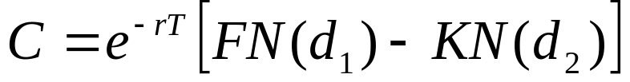

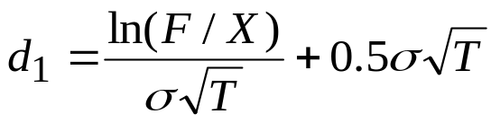
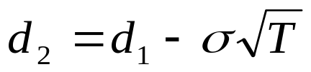
Black’s Model
The B&S formula for a European call on a stock providing a continuous dividend yield can be written as:
But S e^{-qT} e^{rT} is the forward price F
This is Black’s Model for pricing options

Slide 11
Example (Hull 5th ed. 22.3)
1-year cap on 3 month LIBOR
Cap rate = 8% (quarterly compounding)
Principal amount = $10,000
Maturity 1 1.25
Spot rate 6.39% 6.50%
Discount factors 0.9381 0.9220
Yield volatility = 20%
Payoff at maturity (in 1 year) =
Max{0, [10,000 × (r – 8%)×0.25]/(1+r × 0.25)}

Slide 12
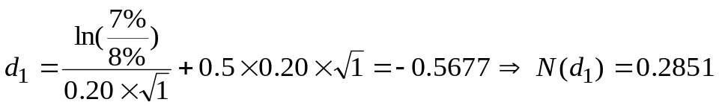
Example (cont.)
Step 1 : Calculate 3-month forward in 1 year :
    F = [(0.9381/0.9220)-1] × 4 = 7% (with simple compounding)
Step 2 : Use Black
Value of cap =
10,000 × 0.9220× [7% × 0.2851 – 8% × 0.2213] × 0.25 = 5.19
cash flow takes place in 1.25 year

Slide 13
For a floor :
N(-d₁) = N(0.5677) = 0.7149 N(-d₂) = N(0.7677) = 0.7787
Value of floor =
10,000 × 0.9220× [ -7% × 0.7149 + 8% × 0.7787] × 0.25 = 28.24
Put-call parity : FRA + floor = Cap
-23.05 + 28.24 = 5.19
Reminder :
Short position on a 1-year forward contract
Underlying asset : 1.25 y zero-coupon, face value = 10,200
Delivery price : 10,000
FRA = - 10,000 × (1+8% × 0.25) × 0.9220 + 10,000 × 0.9381
= -23.05
- Spot price 1.25y zero-coupon + PV(Delivery price)

Slide 14
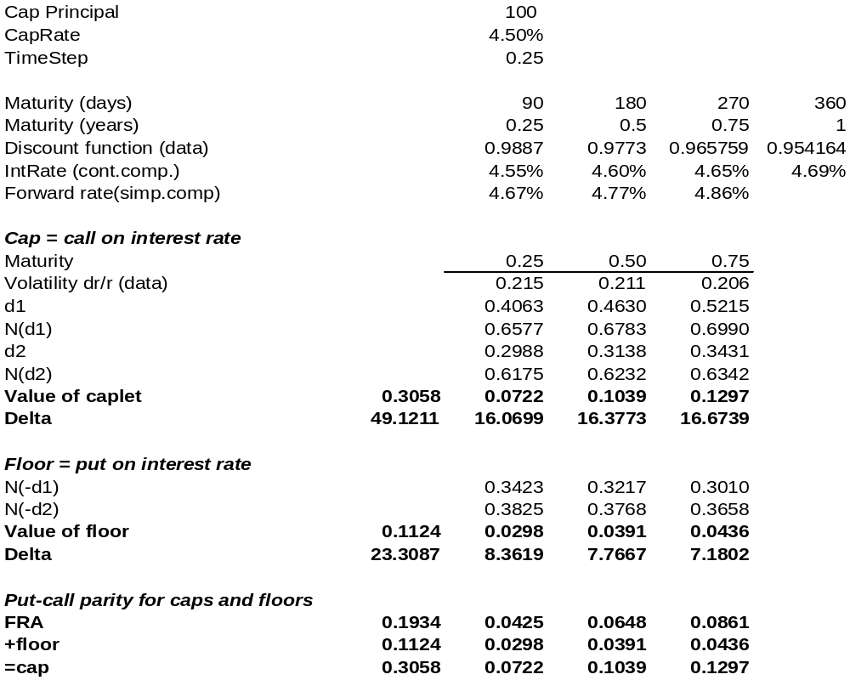
1-year cap on 3-month LIBOR
Notes:
This example is from Jarrow and Turnbull, Derivative Securities, South-Western College Publishing, 1996
The variable rate is the 3-month LIBOR.
There are 3 reset dates: in 90 days, 180 days and 270 days.
The term structure and the volatility of forward interest rates are given as data.
The total cost of a 1-year cap is 0.3058. This is the sum of the value of the individual caplets. As the cap principal is 100, the cost of the cap is 30.58 bp.
The delta of a caplet is based on the following formula:
Cap principal * N(d₁) * Time step * Discount factor
For instance, the delta of the caplet maturing in 90 days is:
100 * 0.6577 * 0.25 * 0.9773 = 16.0699
To understand this, remember that the underlying variable is an interest. If all forward rate were to increase by 1%, the value of the cap would increase by 0.491211%
Note that the sum of the values of the individual FRA is the value of a 9-month swap based on 3-month LIBOR starting in 3-month (cash flows take place in 180, 270 and 360 days) with a fixed rate of 4.50%

Slide 15
Using bond prices
In previous development, bond yield is lognormal.
Volatility is a yield volatility.
σ_{y} = Standard deviation (Δy/y)
We now want to value an IR option as an option on a zero-coupon:
    For a cap: a put option on a zero-coupon
    For a floor: a call option on a zero-coupon
We will use Black’s model.
Underlying assumption: bond forward price is lognormal
To use the model, we need to have:
    The bond forward price
    The volatility of the forward price

Slide 16
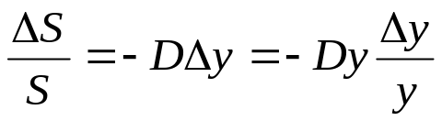
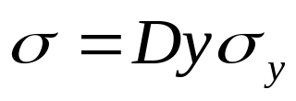
From yield volatility to price volatility
Remember the relationship between changes in bond’s price and yield:
D is modified duration
This leads to an approximation for the price volatility:

Slide 17
Back to previous example (Hull 4th ed. 20.2)
1-year cap on 3 month LIBOR
Cap rate = 8%
Principal amount = 10,000
Maturity 1 1.25
Spot rate 6.39% 6.50%
Discount factors 0.9381 0.9220
Yield volatility = 20%
1-year put on a 1.25 year zero-coupon
Face value = 10,200 [10,000 (1+8% * 0.25)]
Striking price = 10,000
Spot price of zero-coupon = 10,200 * .9220 = 9,404
1-year forward price = 9,404 / 0.9381 = 10,025
3-month forward rate in 1 year = 6.94%
Price volatility = (20%) * (6.94%) * (0.25) = 0.35%
Using Black’s model with:
F = 10,025
K = 10,000
r = 6.39%
T = 1
σ = 0.35%
Call (floor) = 27.631 Delta = 0.761
Put (cap) = 4.607 Delta = - 0.239

Slide 18
Interest rate model
The source of risk for all bonds is the same: the evolution of interest rates. Why not start from a model of the stochastic evolution of the term structure?
Excellent idea
……. difficult to implement
Need to model the evolution of the whole term structure!
But change in interest of various maturities are highly correlated.
This suggest that their evolution is driven by a small number of underlying factors.
Notes:
My objective here is not to provide a detailed exposition of a huge academic litterature. The practical relevance of the problem is obvious: interest rate risk is one of the main risk faced by financial institutions worldwide. Being able to price and to hedge correctly this risk is of huge practical importance.
Sticking to Black Scholes raises an obvious problem. First, of course, the risk-free interest is assumed to be constant. Not a very good starting point to analyze interest-rate sensitive derivatives.
But also, bonds share a common source of risk. The risk on a 5-year bond is closely link to the risk of a 6-year bond. When modeling the stochastic evolution of each bond separately, the common source of risk is lost.
This is why developing a consistent framework for valuing interest rate derivative has been so high on the research agenda for so many years.

Slide 19
Using a binomial tree
Suppose that bond prices are driven by one interest rate: the short rate.
Consider a binomial evolution of the 1-year rate with one step per year.
r_{0,2} = 6%
r_{0,1} = 5%
r_{0,0} = 4%
r_{1,2} = 4%
r_{1,1} = 3%
r_{2,2} = 2%
Set risk neutral probability p = 0.5
Notes:
A binomial model is introduced at this stage as a first step for understanding the valuation of options of bonds and interest rates. The presentation is based on Stapleton and Subrahmanyam, “Interest Rate Caps and Floors” Chap. 6 in Figlewski, S., W. Silber and M. Subrahmanyam, Financial options: From Theory to Practice, Irwin 1990.
We will first suppose that the binomial tree is given. Building a consistent binomial tree is a tricky matter as we will later discover.

Slide 20
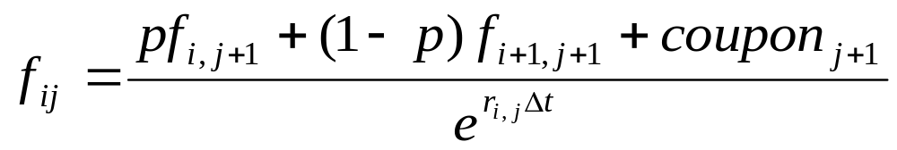
Valuation formula
The value of any bond or derivative in this model is obtained by discounting the expected future value (in a risk neutral world). The discount rate is the current short rate.
i is the number of “downs” of the interest rate
j is the number of periods
Δt is the time step

Slide 21
Valuing a zero-coupon
We want to value a 2-year zero-coupon with face value = 100.
t = 0
t = 1
t = 2
100
95.12
=(0.5 * 100 + 0.5 * 100)/e^{5%}
100
Start from value at maturity
92.32
=(0.5 * 95.12 + 0.5 * 97.04)/e^{4%}
97.04
=(0.5 * 100 + 0.5 * 100)/e^{3%}
100
Move back in tree

Slide 22
Deriving the term structure
Repeating the same calculation for various maturity leads to the current and the future term structure:
t = 0
t = 1
t = 2
t = 3
0 1.0000
0 1.0000
1 0.9418
0 1.0000
1 0.9512
2 0.9049
0 1.0000
0 1.0000
1 0.9608
2 0.9232
3 0.8871
0 1.0000
1 0.9608
0 1.0000
1 0.9704
2 0.9418
0 1.0000
0 1.0000
1 0.9802
0 1.0000

Slide 23
1-year cap
1-year IR call on 12-month rate
Cap rate = 4% (annual comp.)
1-year put on 2-year zero-coupon
Face value = 104
Striking price = 100
t = 0
t = 1
t = 0
1
(r = 5%)
IR call = 1.07%
(r = 5%)
Put = 1.07
ZC = 104 * 0.9512
= 98.93
(5.13% - 4%)*0.9512
(r = 4%)
IR call = 0.52%
(r = 4%)
Put = 0.52
(r = 4%)
IR call = 0.00%
(r = 3%)
Put = 0.00

Slide 24
2-year cap
Valued as a portfolio of 2 call options on the 1-year rate interest rate
(or 2 put options on zero-coupon)
Caplet Maturity Value
1 1 0.52% (see previous slide)
2 2 0.51% (see note for details)
Total 1.03%
Notes:
Here are the details for the calculation of the market value of the 2-year caplet.
t = 0 t = 1 t = 2
r = 6%
Caplet = 2.06%
r = 5%
Caplet = 1.02%
r = 4% r = 4%
Caplet = 0.51% Caplet = 0.08%
r = 3%
Caplet = 0%
r = 2%
Caplet = 0%
The value of the caplet at maturity can be calculated as:
Max(0, R – 4%) e^{-r} where R is the 1-year rate with annual compounding
Or
Max(0, 100 – 104 e^{-r}) a put on a zero-coupon

Slide 25
Swaption
A 1-year swaption on a 2-year swap
    Option maturity: 1 year
    Swap maturity: 2 year
    Swap rate: 4%
Remember: Swap = Floating rate note - Fix rate note
Swaption = put option on a coupon bond
    Bond maturity: 3 year
    Coupon: 4%
    Option maturity: 1 year
    Striking price = 100

Slide 26
Valuing the swaption
t = 0
t = 1
t = 2
t = 3
Coupon = 4
Coupon = 4
Bond = 100
r =6%
Bond = 97.94
r =5%
Bond = 97.91
Swaption = 2.09
Bond = 100
r =4%
Bond = -
Swaption = 1.00
r =4%
Bond = 99.92
r =3%
Bond = 101.83
Swaption = 0.00
Bond = 100
r =2%
Bond = 101.94
Bond = 100
Notes:
The value of the swaption is the value of a 1-year put option on a 3-year bond with an annual coupon of 4%.
The first part of the calculation consist in determining the possible values of the coupon bond at the maturity of the option.
These values are obtained by starting from the terminal value of the bond at maturity and moving back through the tree. The value at each node is obtained by discounting the risk-neutral future value (cum coupon) at the current risk-free interest rate.
For instance, the value of the bond in year 2 if the current interest rate is 6% is:
(0.5 * 100 + 0.5 * 100 + 4) / e^{6%} = 97.94
The next step is to value to swaption (alias the put option) at maturity (in year 1) based on the usual valuation formula Max(0, S_{T} – K)
The final step is to obtain the current value of the swaption following the usual binomial procedure.

Slide 27
Vasicek (1977)
Derives the first equilibrium term structure model.
1 state variable: short term spot rate r
Changes of the whole term structure driven by one single interest rate
Assumptions:
    Perfect capital market
    Price of riskless discount bond maturing in t years is a function of the spot rate r and time to maturity t: P(r,t)
    Short rate r(t) follows diffusion process in continuous time:
dr = a (b-r) dt + σ dz
Notes:
Oldrich Vasicek is the father of modern term structure theories. He is the 2002 winner of the Lifetime Achievement Award of Risk magazine.
A native of the Czech republic, he holds a PhD in Probability Theory. He left Prague in 1968 following the Soviet invasion. He ended up working in the Management Science Department of Wells Fargo, a pioneer in the applications of modern finance. After a spell in the academic life, he later co-founded KMV Corporation in San Francisco, a company specialized in credit risk analysis (KMV was lately bought by Moody’s).
“Vasicek realised that arbitrage would link bond prices up and down the term structure, so, for example, there had to be a relationship between investing in a one-year bond twice in succession and investing in a two-year bond straight off. He found the common denominator to be the short-term interest rate. “If you postulate that the pricing of a long bond is a function of the short rate over the term of the bond, or more accurately, of your probabilistic description short rate’s behaviour over the term of the bond, you have a common variable for the pricing of the bonds”, he notes. “In other words, you have a state variable for the pricing of bonds with all terms from the current value of the short rate – that was the point at which the idea really broke for me at the time”, he says.”
Oldrich Alfons Vasicek, Risk Magazine 15, 1 (2002)
Available at http://db.riskwaters.com

Slide 28
The stochastic process for the short rate
Vasicek uses an Ornstein-Uhlenbeck process
dr = a (b – r) dt + σ dz
    a: speed of adjustment
    b: long term mean
    σ : standard deviation of short rate
Change in rate dr is a normal random variable
The drift is a(b-r): the short rate tends to revert to its long term mean
    r>b ⇒ b – r < 0 interest rate r tends to decrease
    r<b ⇒ b – r > 0 interest rate r tends to increase
Variance of spot rate changes is constant
Example: Chan, Karolyi, Longstaff, Sanders The Journal of Finance, July 1992
Estimates of a, b and σ based on following regression:
r_{t+1} – r_{t} = α + β r_{t} +ε_{t+1}
a = 0.18, b = 8.6%, σ = 2%
Notes:
A numerical example might help to understand the model.
Suppose that the current short-term rate is 3% and that the stochastic process for the short rate is:
dr = 0.20 (6% - r) dt + 1% dz
This mean a = 0.20, b = 6% and σ = 1%
Consider a short period of time, say Δt = 1/12 year (one month)
Remember that dz is a Gaussian random variable with mean zero and standard deviation equal to √Δt.
Over one month, the change in the short rate is a normal random variable with:
Mean = 0.20 (6% - 3%) * (1/12) = 0.05% (a drift of + 5 bp)
Standard deviation = 1% * √1/12 = 0.29% (a volatility of 29 bp)
Note that because of the drift a(b-r), the process is mean reverting. The short rate is pulled back toward its long term value. The parameter a is a measure of the speed of adjustment: the larger a, the faster r reverts to the mean.
Also note that in this formulation, the volatility of dr is the same, whatever the level of the short rate.

Slide 29
Pricing a zero-coupon
Using Ito’s lemna, the price of a zero-coupon should satisfy a stochastic differential equation:
dP = m P dt + s P dz
This means that the future price of a zero-coupon is lognormal.
Using a no arbitrage argument “à la Black Scholes” (the expected return of a riskless portfolio is equal to the risk free rate), Vasicek obtain a closed form solution for the price of a t-year unit zero-coupon:
P(r,t) = e^{-y(r,t) * t}
with y(r,t) = A(t)/t + [B(t)/t] r₀
For formulas: see Hull 4th ed. Chap 21.
Once a, b and σ are known, the entire term structure can be determined.
Notes:
The mathematical development are long (and tedious). I don’t think that Hull does a very good job at explaining the model. My preferred reference for this is Donal Van Deventer and Kenji Imai Financial Risk Analytics – A Term Structure Model Approach for Banking, Insurance and Investment Management, Irwin 1997.
The final result is pretty simple. The yield on a t-year zero-coupon is a linear function of the short rate (in modern parlance, an affine model).
The expression for A(t) and B(t) are impressive but once in a spreadsheet, they are easy to use.
B(t) =(1 – e^{-at})/a
A(t) =(b+λσ/a)[t-B(t)] – 0.5{σ² [t-B(t)]/a² – σ² B(t)² /(2a)}
Where λ is the price of risk.
More explanations on demand.
Be careful: my notations are different from those used in Hull

Slide 30
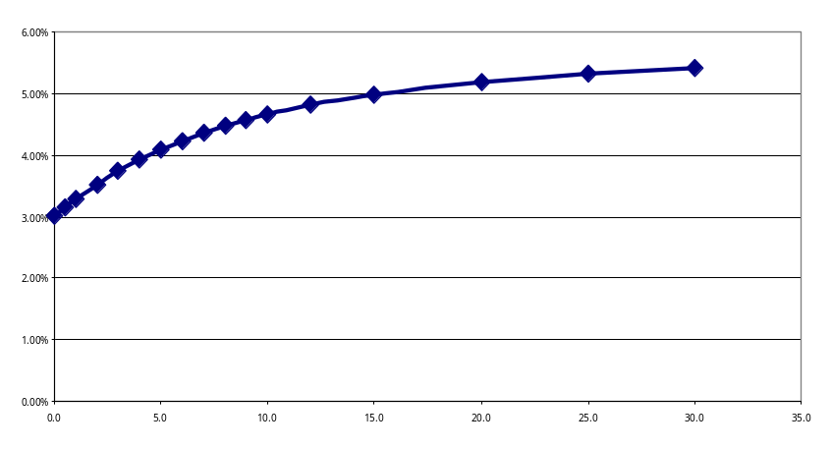
Vasicek: example
Suppose r = 3% and dr = 0.20 (6% - r) dt + 1% dz
Consider a 5-year zero coupon with face value = 100
Using Vasicek:
    A(5) = 0.1093, B(5) = 3.1606
    y(5) = (0.1093 + 3.1606 * 0.03)/5 = 4.08%
    P(5) = e^{- 0.0408 * 5} = 81.53
The whole term structure can be derived:
Maturity Yield Discount factor
1 3.28% 0.9677
2 3.52% 0.9320
3 3.73% 0.8940
4 3.92% 0.8549
5 4.08% 0.8153
6 4.23% 0.7760
7 4.35% 0.7373

Slide 31
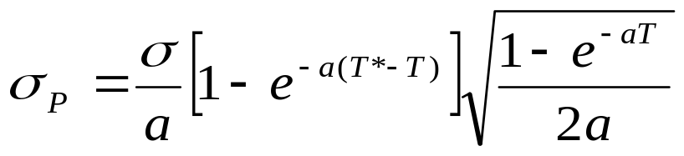
Jamshidian (1989)
Based on Vasicek, Jamshidian derives closed form solution for European calls and puts on a zero-coupon.
The formulas are the Black’s formula except that the time adjusted volatility σ√T is replaced by a more complicate expression for the time adjusted volatility of the forward price at time T of a T*-year zero-coupon

